Slide 1
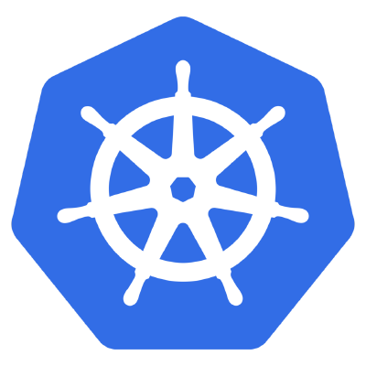

What is Kubernetes?
Brought to you by

Slide 2
Kubernetes (often referred to as K8s) is an open-source container-orchestration system for automating deployment, scaling and management of containerized applications.
It was originally designed by Google and is now maintained by the Cloud Native Computing Foundation. It aims to provide a "platform for automating deployment, scaling, and operations of application containers across clusters of hosts". It works with a range of container tools, including Docker.

Slide 3

Kubernetes (κυβερνήτης, Greek for "governor", "helmsman" or "captain") was founded by Joe Beda, Brendan Burns and Craig McLukie.
First announced and Opensourced by Google in mid-2014.
The original codename for Kubernetes within Google was Project Seven, a reference to Star Trek character Seven of Nine. The seven spokes on the wheel of the Kubernetes logo are a nod to that codename.

Slide 4
Why you should learn Kubernetes?
In the world of DevOps and Systems Engineering, the demand for Kubernetes is growing.
The future of cloud computing is moving toward containerization .
Kubernetes is a great container platform.
Kubernetes is a great microservices platform.
Kubernetes solves a lot of the DevOps problems involving scaling and deployment.

